Slide 1
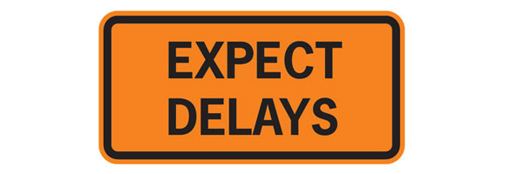
DSI: Delayed Sequence Intubation
Evidence, Rationale, and Methods
Rob Bryant MD
Utah Emergency Physicians

Slide 2
“A procedural sedation, where the procedure is pre-oxygenation”
Who needs it?
Why?
When?
How?
Apneic oxygenation

Slide 3
Safe Apnea:
Duration of apnea until a patient reaches a saturation of 88-90%
Patients with increased metabolic demands desaturate faster.
Patients with shunts desturate faster, and are harder to pre-oxygenate, and re-oxygenate

Slide 4
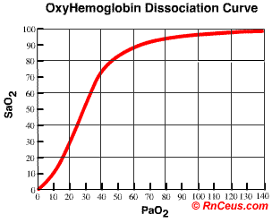
Oxyhemoglobin dissociation curve:

Slide 5
Who gets DSI?
Patients with vital signs that are unobtainable, or unacceptable:
Aggitated head injury / ETOH / Psych
(Good lungs, bad brains)
Hypoxic COPD, Pneumonia, ARDS
(Bad Lungs)

Slide 6
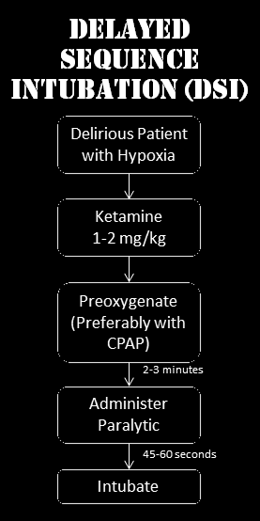
The Basics:

Slide 7
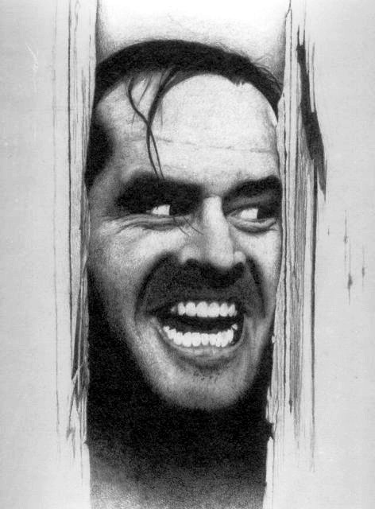
Case One: 44 year old Male, MVC, Possible head injury, Possible ETOH / Meth / Cocaine.
Resisting all EMS interventions.
Arrived in trauma room, no monitor, no IV, swinging at trauma surgeon

Slide 8
Options:
Traditional approach:
IV, Etomidate, Succinylcholine, intubate
Usually works
IF first attempt unsuccessful: Hypoxia, vomit, aspiration, badness

Slide 9
DSI Approach:
IV
1mg / kg Ketamine iv
Place monitoring, (tele, pulse ox, BP)
Allow patient to pre-oxygenate with spontaneous respirations on NRB
1mg /kg Ketamine iv repeated
Paralytic
Intubate with longer safe apnea duration, in calm environment.

Slide 10
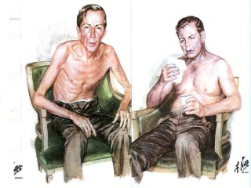
Case Two: 80 year old,
COPD exacerbation, Upright in bed, confused, agitated, sats 85% on NRB,
RR 30, HR 110, BP 160/90

Slide 11
Options:
Traditional approach:
IV, Etomidate, Succinylcholine, intubate
Sats drop precipitously, safe apnea duration 0 sec
IF first attempt unsuccessful: Hypoxia, vomit, aspiration, badness

Slide 12
DSI Approach:
1mg / kg Ketamine iv
Place patient on NIV while sitting, Vent is used in invasive CPAP mode
PEEP can be titrated 5-15 cm H2O
allow sats to rise to > 95%, allow patient to breath for further 3 minutes to denitrogenate
1mg /kg Ketamine iv repeated
Paralytic
Intubate with longer safe apnea duration, in calm environment.
If first attempt unsuccessful, use BVM with PEEP valve set to pre-ox PEEP level

Slide 13
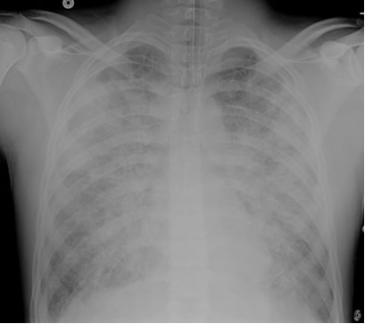
Case Three: 30 Year old male,
Possible OD, found down at home, BIBA,
GCS 12, Sats 85% on NRB, RR 30,
BP 140/90, confused.

Slide 14
Options:
Traditional Approach:
Etomidate, Succinylcholine, intubate
Sats drop precipitously,
no safe apnea period,
high risk for need for BVM ventilation and vomiting with aspiration

Slide 15
DSI Approach:
1 mg / kg Ketamine iv
Place patient on NIV with invasive CPAP settings using vent
Adjust PEEP 5-15 cm H2O
Allow sats to rise to >95% (may take >5 min), allow patient to breathe for further 3 min to denitrogenate
1mg / kg Ketamine iv repeat dose
Paralytic, intubate with longer safe apneic duration
If first attempt unsuccessful use BVM with adjustable PEEP valve.

Slide 16
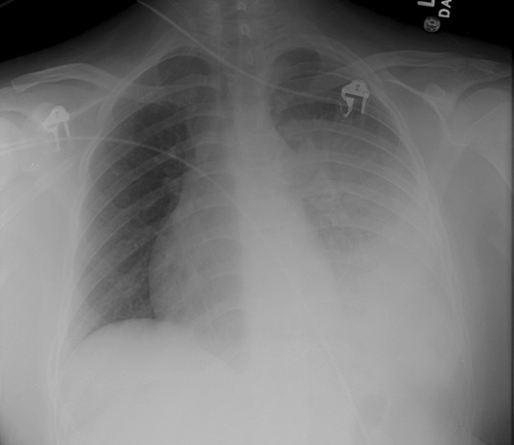
Case Four: 85 year old, nursing home pt, sats 93% NRB, RR 55, BP 140/80, HR 110, temp 38.5C
Placed on NIV, tiring out, tolerating NIV mask.

Slide 17
Options:
Traditional Approach:
Etomidate, Succinylcholine, Intubate.
Risk of rapid desaturation, need for BVM ventilation, vomiting, and difficulty re-oxygenating

Slide 18
DSI Approach:
Leave Pt on NIV
Give 1mg / kg Ketamine, then paralytic
Leave NIV on until apneic, have PEEP valve ready for BVM if necessary
Intubate
Ketamine leaves airway reflexes intact until paralysed to enable shorter period off NIV before intubation attempt.

Slide 19
Apneic Oxygenation:
Alveoli continue to take up oxygen even without diaphragmatic movement or lung expansion
250ml / minute of oxygen moves from alveoli to bloodstream
8-20 ml / minute of carbon dioxide loves into alveoli during apnea
This difference in gas delivery / absorption causes slightly subatmospheric pressure in alveoli, generating a mass flow of gas from pharynx to alveoli
Nasal Cannula at 10-15 l/min after induction agent, left in place during intubation attempt(s) can further prolong duration of safe apnea

Slide 20
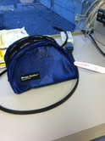
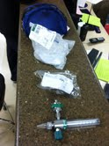
DSI Bags:

Slide 21
DSI Protocol
DSI (Delayed Sequence Intubation) Guidelines
Equipment:
Nasal cannula Non-rebreather mask ETCO2 monitor
Ventilator Non-vented mask with straps 10 cc syringe
BVM with adjustable PEEP valve 2 O2 flow meters tape and ties
Procedure:
Preoxygenation Period:
Position the patient in a semi-recumbent position (≈20°) or in reverse Trendelenberg. Position (ramping) the patient’s head in the ear to sternal notch position using padding if necessary.
Place the nasal cannula on the patient with the flow turned to 10 lpm.
Place the patient on a non-rebreather facemask at maximal flow.
Set ventilator at patient appropriate settings for CPAP and CMV.
If the patient is not oxygenating (SpO2 > 90%), remove the face mask and switch to non-invasive CPAP using the ventilator in invasive CPAP mode, non vented mask and straps, or BVM with PEEP valve.
If patient is agitated and not tolerating CPAP, give first dose of Ketamine
Titrate PEEP between 5-15 cmH2O to achieve an oxygen saturation > 95%. Titrate based on patients hemodynamic status.
Allow patient to breath at tidal volume for 3 minutes or ask the patient to perform 8 maximal exhalations and inhalations.
Attach the BVM to an oxygen source. If the patient required CPAP for preoxygenation, attach the adjustable PEEP valve to the BVM set at the patient’s current CPAP level on the ventilator.
Apneic Period:
Push sedative-hypnotic and paralytic
Remove the face mask from the patient and detach from the oxygen flow meter.
Increase the flow of the nasal cannula to 15 LPM.
Perform a jaw thrust to maintain pharyngeal patency.
If the patient is high risk (required CPAP for preoxygenation), consider leaving on CPAP during the apneic period or providing 4-6 ventilations with the BVM with attached PEEP valve. Maintain a two-hand mask seal during the entire apneic period to maintain the CPAP.
Intubation Period:
Leave the nasal cannula on throughout the airway management period to maintain apneic oxygenation.

Slide 22
NAP4 Audit on all airway complications in Great Britain:
Mortalilty is higher in the ED and ICU than in the OR. Our patients are sicker, so we must be more diligent in planning.
THERE WAS A FAILURE TO PLAN FOR FAILURE
Quantitative waveform ETCO2 should be the standard of care for every ED and ICU intubation
Obesity played a role in a large percentage of cases
Awake intubation not performed when indicated
Needle Cricothyrotomy failed more than surgical cric.
Junior resident anesthesiologists were responding to ED and ICU when airway assistance was requested.

Slide 23
References:
Preoxygenation and Prevention of Desaturation During Emergency Airway Management.Weingart , Levitan, Annals of Emergency Medicine, article in press.
Emcrit Podcast, www.emcrit.org, podcast 40, January 31, 2011
Preoxygenation, Reoxygenation, and Delayed Sequence Intubation in the Emergency Department. Weingart, S. J Emerg Med. 2010 Apr 7.

