Slide 1

Are physicians required during winch rescue missions in an Australian helicopter emergency medical service?
Sherren PB, Hayes-Bradley C, Reid C, Burns B, Habig K
Greater Sydney Area HEMS

Slide 2

Greater Sydney Area HEMS
Greater Sydney area HEMS operates a physician and paramedic team providing pre-hospital and inter-hospital retrievals to critically ill and injured patients
3000 mission per year utilising rotary wing, fixed wing or road platforms
Three winch-capable helicopters provide a 24 hour service, covering the varying topography of greater Sydney area

Slide 3
Advantages of a winch capable HEMS
Access patients in difficult terrain and expediting transport times
Deliver of a physician to the scene where the patient can receive critical interventions
Advanced pre-hospital interventions are frequently required in patients that have fallen from a height in GSA-HEMS Janssen DJ et al. Injury 2012 May 23

Slide 4
Risks and problems?
Increased risk of winch-related incidents and fatalities Hinkelbein J et al. Open Access Emerg Med 2010;2:45–9.
Maintaining winch currency for over 40 physicians on two helicopter types also incurs a significant financial and training burden
SCAT paramedics vastly more experience

Slide 5
Aim
Describe the patient demographics and range of interventions performed during rescue missions involving the winching of a physician

Slide 6
Methods
All winch missions involving a physician from August 2009 to January 2012 were identified from the GSA-HEMS database
A structured and anonymous case sheet review was conducted by two independent abstractors
Case sheets were scrutinised for a predetermined list of demographic data and physician only interventions (POI)

Slide 7
Physician only interventions
Analgesia/procedural sedation (Ketamine or fentanyl) and total dose used.
Regional anaesthesia/Nerve block
Rapid sequence induction and intubation (RSI)
Surgical airway
Thoracostomy/chest drain
Any other surgery intervention
Adult EZ-intraosseous access
Blood transfusion
Orthopaedic manipulation of joint/limb
Use of Ultrasound (diagnostic/procedural)
Hypertonic Saline administration

Slide 8
Results
130 missions and 134 patients were identified
After excluding those with missing data (n = 14), 120 cases were available for analysis
The majority of patients were traumatically injured (93%) and male (85%)
The median (IQR) age for all patients was 37 (26-53) years
The median (IQR) scene times was 42.5 (30-58) mins.
Seven patients were pronounced life extinct on the scene

Slide 9
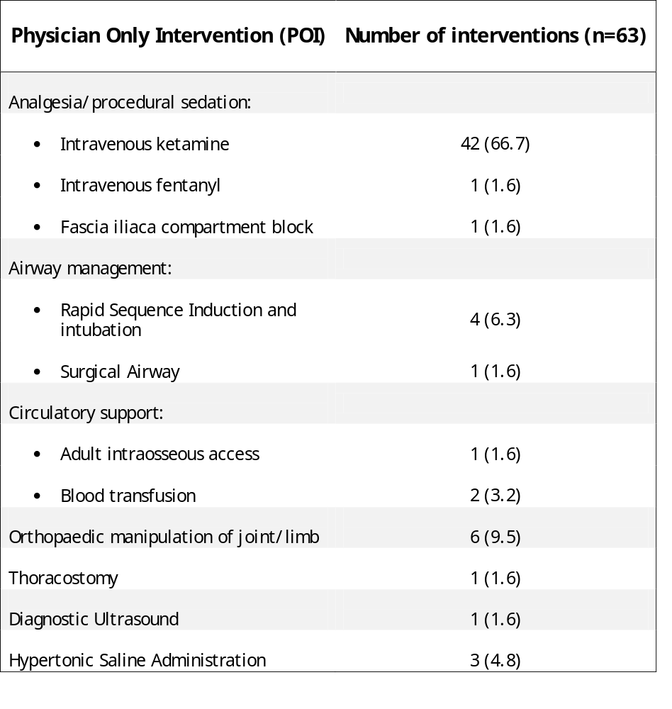

Slide 10
Abnormal RTSc² and association with Physician only interventions, in patients that were not pronounced life extinct on the scene (n=113)
 | Physician only intervention performed (n=46) |  | No Physician intervention performed (n=67) |  | P – Value
Normal RTS_{c}² | 39 |  | 65 |  | 0.03*
Abnormal RTS_{c}² | 7 |  | 2

Slide 11
Effect of Physician only interventions on scene times
 | Physician only Intervention performed | No physician only intervention performed | P -Value
Scene time in minutes, median (IQR) | 45 (30-65) | 43 (31-60) | 0.51

Slide 12
Summary
40% of patients received a POIs
Advanced analgesia/sedation was by far the most common POI, with the use of ketamine predominating
Other critical interventions were carried out in smaller numbers
Patients with abnormal RTS_{c}² were more likely to receive a POI (p-0.03)
In patients that were attended to by a physician, the undertaking of a POI had no impact on the scene time (p-0.51)

Slide 13
Conclusion
A high POI rate of 40% coupled with long rescue times and the occasional severe injuries supports the argument for winching doctors within our service
Not doing so would deny a significant population of time critical interventions, advanced analgesia and procedural sedation

Slide 14
Limitations
With any retrospective study the potential for missed data exists
14 case sheets could not be located and were a potential source of bias. This group had similar demographics to the study population
A physician offers other potential benefits beyond drug administration and practical procedures including appropriate triaging and dynamic decision making
In some services Ketamine can be administered by paramedics and would therefore not constitute a POI

Slide 15
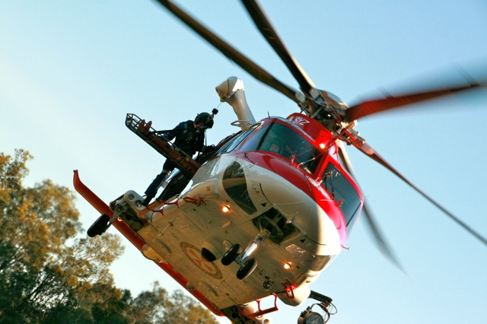
Questions?

