Slide 1

Early coagulopathy and lethal triad in burns patients: an issue for pre-hospital care?
Sherren PB, Kundishora T, Hussey J, Martin R, Emerson B
Department of Anaesthesia and Intensive Care, St. Andrew’s Burn Centre

Slide 2
The lethal triad
The ‘lethal triad’ is a well described entity in the trauma population and is associated with significant mortality. Moore EE. Am J Surg 1996;172:405-410
Major burn patients are exposed to similar physiological insults
Little is known about the incidence and effect of an early coagulopathy and lethal triad in burns patients
A lethal triad could impact on early surgical procedures, CVS stability and septic complications

Slide 3
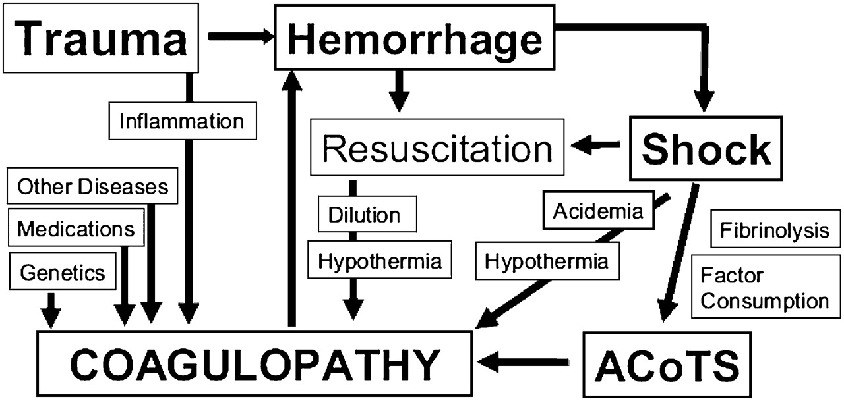

Slide 4
Coagulopathy
Acute traumatic coagulopathy (ATC) is a well described phenomenon in the trauma population associated with significant mortality Brohi K et al. J Trauma. 2003;54:1127-1130
ATC is an impairment of haemostasis involving a complex dynamic interaction between endogenous anticoagulants and fibrinolysis
ATC is driven by an endothelial injury and hypoperfusion, which results in in increased thrombomodulin expression and APC
An early burn induced coagulopathy has yet to be demonstrated

Slide 5
Hypothermia
Significant problem!
Factors involved
  Large volume fluid resuscitation
  Thermal tissue injury impairs skin’s insulating ability
  Anaesthesia impacts thermoregulation
  Impaired endogenous heat production as a result of anaerobic metabolism
  Reluctance to warm burn patients by medical professionals?

Slide 6
Acidaemia
Major burns are characterised by
  Direct endothelial injury
  Systemic hypoperfusion
  Hypovolaemia/ haemoconcentration
  Impaired myocardial contractility and cellular hypoperfusion.
This decreased oxygen delivery results in a shift to anaerobic metabolism, lactate production and metabolic acidaemia
The initial lactate is a strong predictor of mortality in burns patients. Latenser BA. Crit Care Med. 2009 Oct;37(10):2819-26

Slide 7
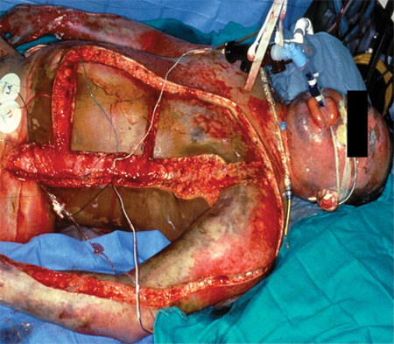

Slide 8
Aim
The primary aim of this study was to identify a clinically significant early burn induced coaguloapthy and lethal triad in thermal injuries
We also sought any association with the validated abbreviated burn severity index (ABSI), fluid administration and mortality

Slide 9
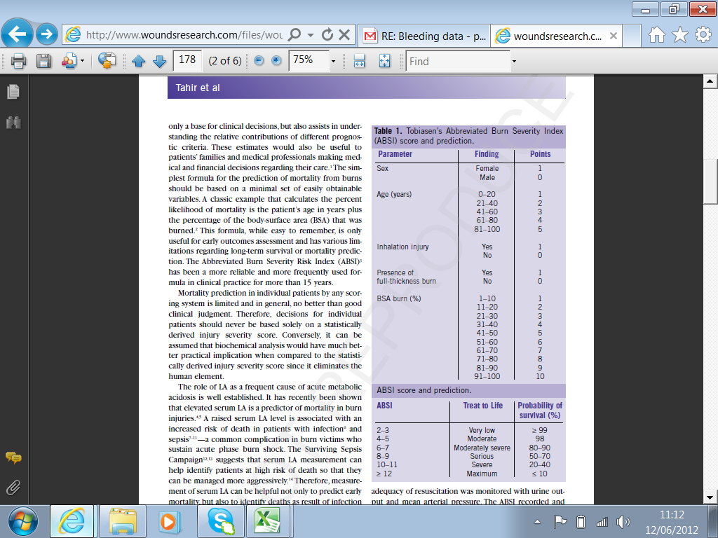
Abbreviated Burn Severity Index

Slide 10
Methods
Patients with TBSA burns ≥30% from October 2008 to December 2011 were identified from the metavision database
A structured and anonymous metavision review was conducted
The database was scrutinised for a predetermined list of demographics, interventions, admission observations and investigations
Exclusion criteria were: associated major trauma, arrival at the burn centre>12 hours after burn, significant CO/Cyanide poisoning, pre-existing coagulopathy, any PRBC/FFP/PCC administration and non-thermal injuries

Slide 11
Definitions
Coagulopathy - PT≥14.7/APTT≥45 seconds (Local lab. reference & Davenport et al. Crit Care Med 2011;39(12):2652-2658)
Hypothermia - Temperature≤35.5°C
Acidaemia - pH≤7.25

Slide 12
Lethal Triad
total cases reviewed
(n=205)
excluded
(n=60)
missing data
(n=28)
Lethal triad
(n=15)
Non Triad group
(n=102)

Slide 13
Demographics | Lethal Triad |  | P-value
 | Present (n=15) | Absent (n=102)
Age in years, mean (SD) | 46 (20.9) | 33.0 (21.9) | 0.033*
Sex (M/F) | 10/5 | 65/37 | 1
TBSA burn, mean (SD) | 59.2 (18.7) | 47.9 (18.1) | 0.027*
Inhalational injury present | 13 (86.7%) | 31 (30.4%) | <0.0001*
Abbreviated burn severity index, median (IQR) | 12 (9-13) | 8.5 (6-10) | 0.0011*
Time from burn to arrival Burn Centre in minutes, mean (SD) | 352 (107.5) | 361.5 (160.8) | 0.83
Fluid received prior to arrival at Burns centre. ml, mean (SD) | 4783.3 (2140.1) | 4167.1 (2910.6) | 0.43
Fluid deficit according to Parkland formula on arrival in Burns centre. ml, mean (SD) | 1903.2 (2095.6) | 301.7 (2287.5) | 0.012*
Mortality rate at 28 days (%) | 10/15 (66.7) | 12/102 (11.8) | <0.0001*

Slide 14
Coagulopathy
39.3% of the 117 patients were coagulopathic on admission
There was no significant correlation between the PT and volume of fluid administered (p - 0.095, r - 0.155)
The 28 day mortality rate for patients with a coagulopathy of 39.1% was significantly higher than the 8.5% of those with normal coagulation (p-0.0001)
The predictive value of an early coagulopathy in regards to 28 day mortality was sought using logistic regression analysis. All components of the ABSI were adjusted for
An earlier coagulopathy was an independent predictor of 28 day mortality, OR 3.42 (1.11-10.56)

Slide 15
Incidence of coagulopathy with ABSI
Pearson product moment correlation coefficient r - 0.292 and p - 0.0013

Slide 16
PT vs serum lactate
Pearson product moment correlation coefficient, r - 0.292 and p - 0.001

Slide 17
Summary
In patients with major thermal injuries there is a clinically significant early burn induced coagulopathy
This coagulopathy correlates to serum lactate and ABSI but is unrelated to fluid administration
An earlier coagulopathy was an independent predictor of 28 day mortality
A subgroup of major burns patients exhibit the lethal triad which is associated with an increased mortality

Slide 18
Conclusion
In the pre-hospital management of major burns it is vital to accurately assess the burn area and resuscitate appropriately to limit tissue hypoperfusion
An acute burn induced coagulopathy has significant bleeding implications for any surgical procedures
Ensure temperature conservation
  Highest possible ambient temperature
  Use of Clingfilm, space blankets and layering techniques
  Use of active warming methods such as heat pads and the En-Flow fluid warmer

Slide 19
Questions?

